Slide 2

Performance Improvements in .NET 7
Stephen Toub - Partner Software Engineer (.NET)

Slide 3


https://devblogs.microsoft.com/dotnet/performance_improvements_in_net_7
Over 500 PRs / improvements discussed (> 20% from outside of the .NET team, yay open source!)
Let’s look at just a representative few…
Through a “lessons” lens

Slide 4

Lesson: Find Ways To Have Your Cake And Eat It, Too
Tiered compilation introduced in .NET Core 3.0
Enables faster startup without sacrificing code quality
Also good for throughput (and a foundational mechanism for dynamic PGO)
But off by default for methods with loops...
…until now
On-Stack Replacement (OSR)
Tracks loop iteration count in tier 0
Triggers tier 1 compilation and jumps to it mid-method

Slide 5

Lesson: Don’t Make Everyone Duplicate Efforts
Reflection invoke has historically had non-trivial overheads
Devs worked around that with reflection emit
Reflection emit approach now built-in
private MethodInfo _zeroArgs = typeof(Program).GetMethod(nameof(ZeroArgsMethod));
private MethodInfo _oneArg = typeof(Program).GetMethod(nameof(OneArgMethod));
private object[] _args = new object[] { 42 };
[Benchmark] public void InvokeZero() => _zeroArgs.Invoke(null, null);
[Benchmark] public void InvokeOne() => _oneArg.Invoke(null, _args);
public static void ZeroArgsMethod() { }
public static void OneArgMethod(int i) { }
| Method | Runtime | Mean |
|----------- |------------------- |-----------:|
| InvokeZero | .NET 6.0 | 45.194 ns |
| InvokeZero | .NET 7.0 | 7.770 ns |
| | | |
| InvokeOne | .NET 6.0 | 82.724 ns |
| InvokeOne | .NET 7.0 | 22.758 ns |

Slide 6
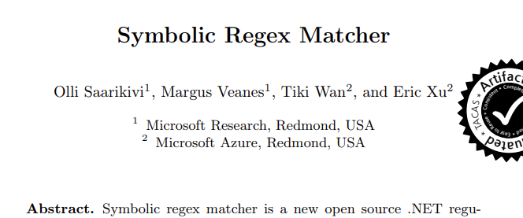



Lesson: CS research is on-going
RegexOptions.NonBacktracking
DateTime.Month/Day/Year
double/float.{Try}Parse

Slide 7
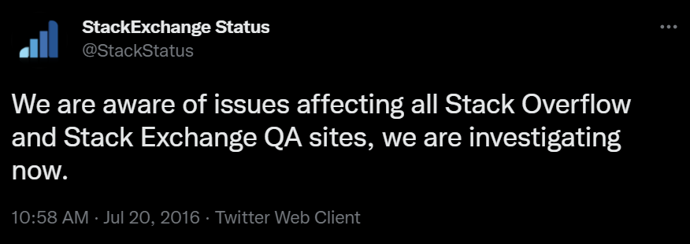
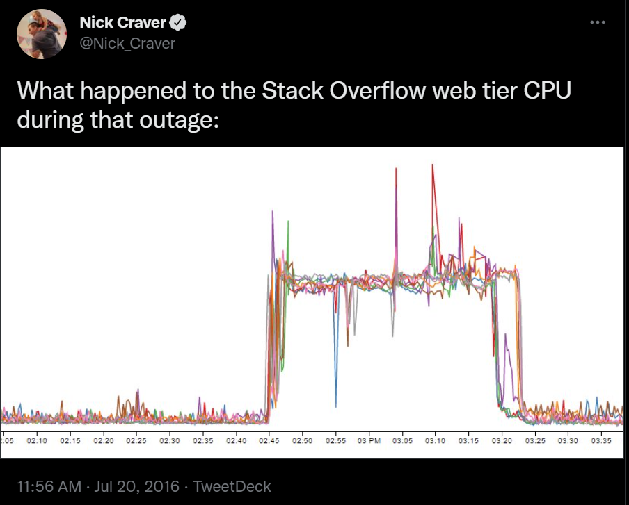
Lesson: CS research is on-going, cont.
| Method | Runtime | Options | BadInput | Mean |
|-------- |------------------- |--------- |--------- |----------------:|
| IsMatch | .NET Framework 4.8 | Compiled | False | 376.16 us |
| IsMatch | .NET 6.0 | Compiled | False | 38.24 us |
| IsMatch | .NET 7.0 | Compiled | False | 33.69 us |
| | | | | |
| IsMatch | .NET Framework 4.8 | Compiled | True | 4,930,723.14 us |
| IsMatch | .NET 6.0 | Compiled | True | 1,144,403.41 us |
| IsMatch | .NET 7.0 | Compiled | True | 475,131.99 us |
| Method | Runtime | Options | BadInput | Mean |
|-------- |----------- |----------------- |--------- |----------------:|
| IsMatch | .NET 7.0 | NonBacktracking | False | 154.98 us |
| IsMatch | .NET 7.0 | NonBacktracking | True | 156.27 us |
[Params(RegexOptions.Compiled, RegexOptions.NonBacktracking)]
public RegexOptions Options { get; set; }
[Params(false, true)]
public bool BadInput { get; set; }
private Regex _regex;
private string _input;
[GlobalSetup]
public void Setup()
{
// https://stackstatus.tumblr.com/post/147710624694/outage-postmortem-july-20-2016
_regex = new Regex(@"^[\s\u200c]+|[\s\u200c]+$", Options);
_input = $"-- play happy sound for player to enjoy{new string(' ', 20_000)}" + (BadInput ? "!" : "");
}
[Benchmark]
public bool IsMatch() => _regex.IsMatch(_input);

Slide 8
Lesson: Built-in helpers are your friends
private static readonly string s_haystack = new HttpClient().GetStringAsync("https://www.gutenberg.org/files/1661/1661-0.txt").Result;
[Params(StringComparison.Ordinal, StringComparison.OrdinalIgnoreCase)]
public StringComparison Comparison { get; set; }
[Params("elementary")]
public string Needle { get; set; }
[Benchmark]
public int Count()
{
int count = 0, pos = 0;
while ((pos = s_haystack.IndexOf(Needle, pos, Comparison)) >= 0)
{
pos += Needle.Length;
count++;
}
return count;
}
| Method | Runtime | Comparison | Needle | Mean |
|------- |--------- |------------------ |----------- |------------:|
| Count | .NET 6.0 | Ordinal | elementary | 1,064.00 us |
| Count | .NET 7.0 | Ordinal | elementary | 57.93 us |
| | | | | |
| Count | .NET 6.0 | OrdinalIgnoreCase | elementary | 2,332.51 us |
| Count | .NET 7.0 | OrdinalIgnoreCase | elementary | 631.75 us |

Slide 9
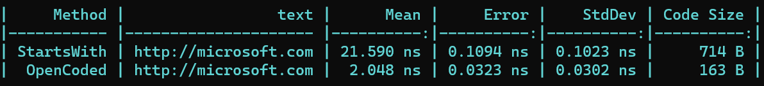
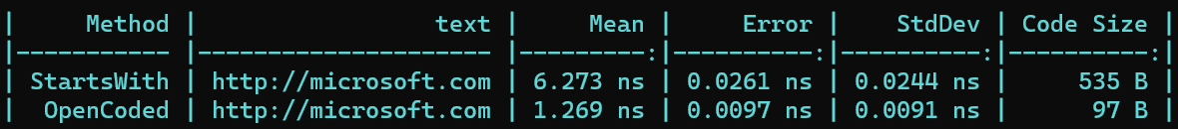
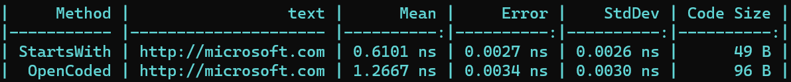

Lesson: Work-arounds Should Be Revisited
[Benchmark]
[Arguments("http://microsoft.com")]
public bool StartsWith(string text) =>
text.StartsWith("https://",
StringComparison.OrdinalIgnoreCase);
.NET Framework 4.8
[Benchmark]
[Arguments("http://microsoft.com")]
public bool OpenCoded(string text) =>
text.Length >= 8 &&
(text[0] | 0x20) == 'h' &&
(text[1] | 0x20) == 't' &&
(text[2] | 0x20) == 't' &&
(text[3] | 0x20) == 'p' &&
(text[4] | 0x20) == 's' &&
text[5] == ':' &&
text[6] == '/' &&
text[7] == '/';
.NET 6
.NET 7
vmovupd xmm0, xmmword ptr [rcx+0CH]
vpor xmm0, xmm0, xmmword ptr [reloc @RWD00]
vpxor xmm0, xmm0, xmmword ptr [reloc @RWD16]
vptest xmm0, xmm0
sete al
movzx rax, al
...
RWD00 dq 0020002000200020h, 0000000000000020h
RWD16 dq 0070007400740068h, 002F002F003A0073h

Slide 10

Lesson: There’s Always More Opportunity
private static Regex s_email = new Regex(@"[\w.+-]+@[\w.-]+.[\w.-]+", RegexOptions.Compiled);
private static string s_text = new HttpClient().GetStringAsync(@"https://raw.githubusercontent.com/mariomka/regex-benchmark/8e11300825fc15588e4db510c44890cd4f62e903/input-text.txt").Result;
[Benchmark]
public int Email()
{
int count = 0;
Match m = s_email.Match(s_text);
while (m.Success)
{
count++;
m = m.NextMatch();
}
return count;
}
| Method | Runtime | Mean | Ratio | Allocated |
|------- |------------------- |---------------:|------:|----------:|
| Email | .NET Framework 4.8 | 1,052,201.9 us | 1.000 | 48 KB |
| Email | .NET Core 3.1 | 917,751.0 us | 0.872 | 43.16 KB |
| Email | .NET 6.0 | 49,043.0 us | 0.047 | 41.96 KB |
| Email | .NET 7.0 | 620.9 us | 0.001 | 41.84 KB |
[Benchmark]
public int Email() => s_email.Count(s_text);
| Method | Runtime | Mean | Allocated |
|------- |------------------- |---------------:|----------:|
| Email | .NET 7.0 | 599.5 us | - |

Slide 11
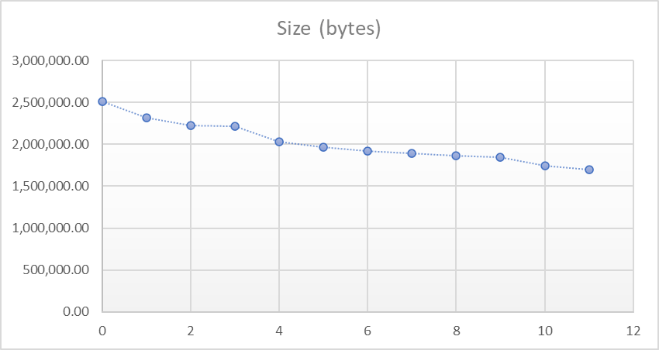
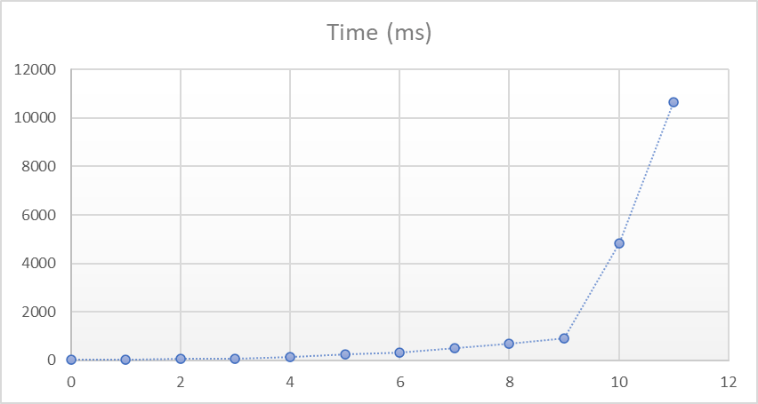
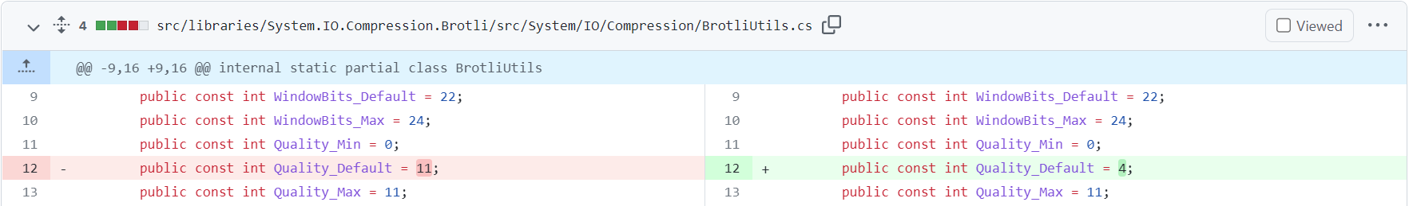

Lesson: Be Thoughtful About Your Defaults
Brotli compression by level on
https://www.gutenberg.org/ebooks/100.txt.utf-8
private byte[] _data = new HttpClient().GetByteArrayAsync("https://www.gutenberg.org/ebooks/100.txt.utf-8").Result;
private Stream _output = new MemoryStream();
[Benchmark]
public void Compress()
{
_output.Position = 0;
using var brotli = new BrotliStream(_output, CompressionMode.Compress, leaveOpen: true);
brotli.Write(_data);
}
| Method | Runtime | Mean | Ratio | Compressed Size | Size Ratio |
|--------- |--------- |-----------:|------:|----------------:|-----------:|
| Compress | .NET 6.0 | 9,755.6 ms | 1.00 | 1,702,274 B | 1.00 |
| Compress | .NET 7.0 | 126.8 ms | 0.01 | 2,027,351 B | 1.19 |

Slide 12

Thanks for joining!

